Slide 1
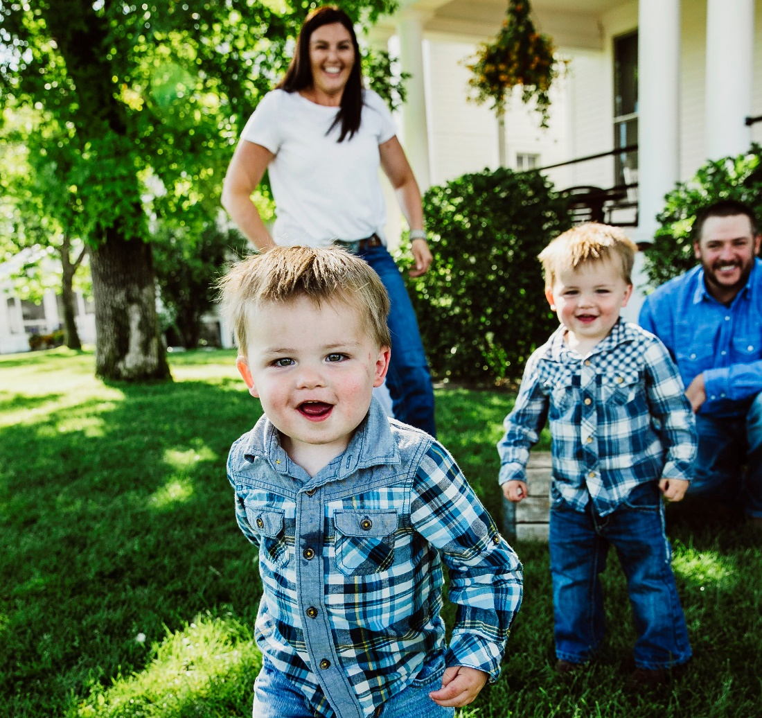
Slide 1
COMMUNITY IMPACT
OF CHILD CARE
Presented by:
Jane Arntzen Schumacher, M.Ed.
Executive Director, Child Care Connections

Slide 2
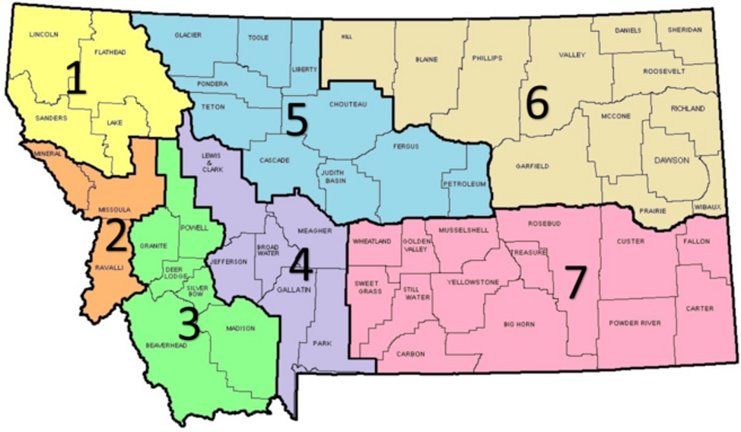
Slide 12
WHO ARE WE?
ABOUT CHILD CARE CONNECTIONS
Child Care Connections (CCC) advocates for the well-being and quality care of children by supporting early childhood professionals, families, and the communities we serve.
We are one of seven (7) Child Care Resource and Referral Agencies in MT and serve:
Gallatin
Park
Meagher
Lewis & Clark
Jefferson
Broadwater
CCC Offices in Bozeman and Helena
https://cccmontana.org/
https://mtchildcare.org

Slide 3
Slide 12
WHAT IS QUALITY CHILD CARE?
Why quality care matters
Quality child care is safe, stimulating, and provides a loving environment in which children mentally and physically thrive.
Over 90% of brain growth occurs between ages 0-5.
Key long-term benefits of quality early childhood care include:
Increased school readiness
Healthy nutrition habits
Advanced verbal and intellectual skills
Advanced social and emotional skills
Strengthened future workforce for our community
https://www.cde.ca.gov/sp/cd/re/caqdefinecare.asp
https://www.cscinc.org/programs/finding-quality-childcare/benefits-of-quality-child-care/
https://www.childrenscabinet.org/child-care-resources/for-parents/why-is-quality-child-care-important/

Slide 4
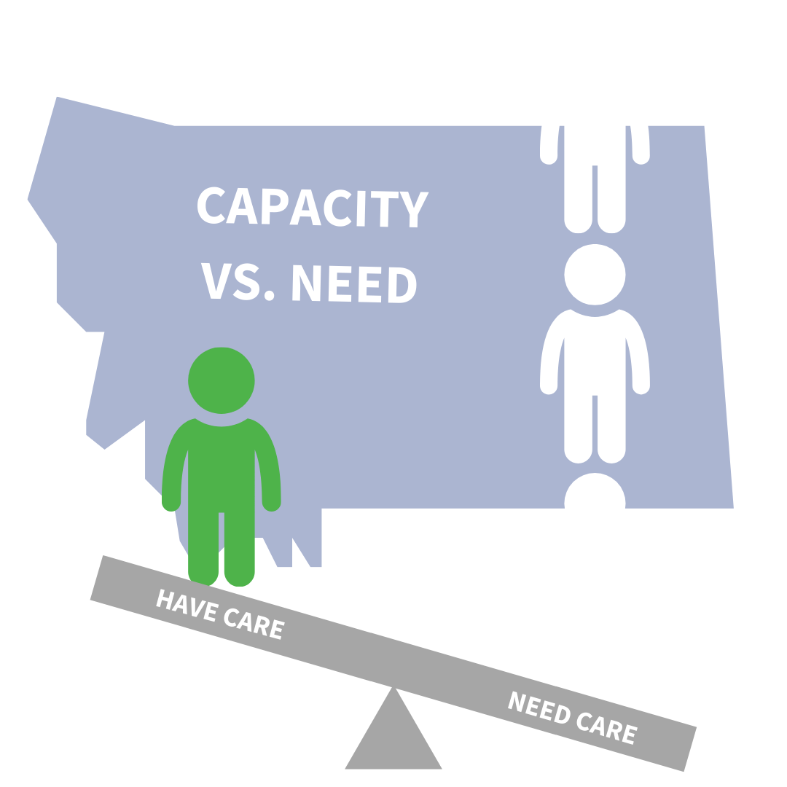
Slide 7
CHILD CARE CAPACITY
Montana is considered a child care desert. This means that most of our communities have 3X as many children ages 0-5 as licensed child care slots.
MT Ranks 42 in child care capacity in the U.S.
http://lmi.mt.gov/Portals/193/Publications/LMI-Pubs/Articles/2018/0918-ChildcareInMontana.pdf/
https://childcaredeserts.org/index.html?state=MT

Slide 5
Slide 2
FAMILY CHALLENGES
Families are impacted deeply by the lack of access to affordable and regulated child care.
They are often left with no choice but unsafe or illegal child care options.
Access to child care impacts how families can participate in the workforce and local economy.
Children
Minimum-Wage Workers
Single Mothers
28 Weeks
42%
56%
Over 25,000 children under the age of 6 are in unregulated child care. That’s 56% of our children who need care.
Minimum wage workers in MT would have to work approximately 28 weeks to pay for child care of one infant.
An estimated 42% of single mothers with children 0-5 are living in poverty. This means that their annual income is $17,000 or less.
http://lmi.mt.gov/Portals/193/Publications/LMI-Pubs/Articles/2018/0918-ChildcareInMontana.pdf
https://static1.squarespace.com/static/5c90fe4716b640613581ddff/t/5cef052b3b10330001757348/1559168304445/Childcare+as+a+Workforce+Issue.pdf
https://static1.squarespace.com/static/5c90fe4716b640613581ddff/t/5cef05a72c94e10001176648/1559168427506/System+of+Early+Childhood+Workforce+Support_KS+version.pdf

Slide 6
Slide 6
COST OF CHILD CARE IN MT
$ 9,518
$ 8,365
Per infant, ages 0-2, annually
Per child, ages 3-5, annually
AFFORDABILITY
ANNUAL FAMILY EXPENSES
Child care is considered affordable if it costs 7% or less of a family’s annual income, according to U.S. DPHHS. Yet, in Montana an average family pays 16.5% for one child.
16.5%
https://www.epi.org/child-care-costs-in-the-united-states/#/MT
http://lmi.mt.gov/Portals/193/Publications/LMI-Pubs/Articles/2018/0918-ChildcareInMontana.pdf
https://datacenter.kidscount.org/data#MT/5/0/char/0

Slide 7
Slide 12
WHY ARE EARLY CHILDHOOD WAGES SO LOW?
Despite the high cost of licensed child care, early childhood professionals are making some of the lowest wages in our state.
$10,643
Cost of care explained:
Parent fees alone are not enough funding
Labor intensive field
Requires low adult to child ratios
Cost breakdown:
12% to overhead, utilities, maintenance
23% classroom materials, food, and admin
65% for personnel
Ex: A center with 40 full-time children needs a minimum of 10 teachers.
Is the annual median salary
of an early childhood educator
with in Gallatin County.
https://usa.childcareaware.org/2018/07/parents-spend-much-child-care-yet-early-childhood-educators-earn-little/ (VIDEO)
https://www.epi.org/child-care-costs-in-the-united-states/#/MT
https://lmi.mt.gov/Portals/193/Publications/LMI-Pubs/Labor%20Market%20Publications/EAG-0419.pdf

Slide 8
Slide 3
CHILD CARE AND THE WORKFORCE
Unmet child care demand is both a CAUSE and an EFFECT of the state’s workforce shortage.
WHY WORKERS LEAVE THE WORKFORCE
42%
64%
of MT’s unemployed cite family responsibilities as the reason they are not working.
Of children under the age of 6 in MT have both parents or their only parent in the workforce.
23%
12%
Of partially employed workers in Montana cannot work full-time due to lack of child care.
Mothers are estimated to be out of the workforce in Gallatin County due to child care access issues.
https://www.epi.org/child-care-costs-in-the-united-states/#/MT
http://lmi.mt.gov/Portals/193/Publications/LMI-Pubs/Articles/2018/0918-ChildcareInMontana.pdf
https://www.americanprogress.org/issues/early-childhood/reports/2019/03/28/467488/child-care-crisis-keeping-women-workforce/

Slide 9
Slide 6
CHILD CARE AND ROI MT BUSINESSES
16 : 1
High quality early care programs for at-risk children save the community $16 for every
$1 invested.
INVESTING IN MT JOBS
Fully investing in early care and education would generate millions of sales for MT businesses, and create thousands of jobs.
7,900
NEW JOBS
1,300
Every $1 invested in quality early child care results in a higher economic impact than any other industry in Montana.
NEW JOBS OUTSIDE OF EARLY CARE SECTOR
http://s3.amazonaws.com/mildredwarner.org/attachments/000/000/169/original/report-5755193a.pdf
http://lmi.mt.gov/Portals/193/Publications/LMI-Pubs/Articles/2018/0918-ChildcareInMontana.pdf

Slide 10
Slide 7
COVID RELIEF
On August 19th, $50 million in funding was released by the Early Childhood Services Bureau (ECSB) in four buckets:
$30 million in grants to maintain and expand child care for school-age children during out of school time
Apply at covidrelief.mt.gov
$10 million in scholarships for families with special circumstances
Available August 19th through your local Child Care Resource & Referral Agency (CCR&R)
$8 million in direct support of licensed child care providers
Processing will begin on September 1st, 2020, by ECSB. Contact your local CCR&R agency, with questions.
$2 million for CCR&R agencies for administration and outreach

Slide 11
Slide 12
MIXED DELIVERY PRE-K
What is it?
Why support it?
Mixed delivery systems offer child care and early education to 4 year-old + children in a variety of settings and programs including:
Public School-Based Programs
Head Start
Center-Based Child Care
Family and Group-Based Child Care
Mixed delivery systems:
Increase child care capacity
Offer flexible and affordable quality care that meets the needs of working families
Support better transitions to school
Strengthen existing programs
https://cccmontana.org

Slide 12
Slide 2
THANK YOU!
Download this presentation and access important data and resources on child care at:
cccmontana.org/WhatsNew/Post/Child-Care-Matters
or call (406) 587-7786
Child Care Connections
Jane Arntzen Schumacher, M.Ed.
Executive Director
1143 Stoneridge Dr
Bozeman, MT 59718
901 N Benton Ave
Helena, MT 59601
(406) 587-7786
office@cccmontana.org
cccmontana.org

